Slide 1
A New Algorithm for Data Compression
Byte Pair Encoding (BPE)
Philip Gage
Mark Erokhin (mark.erokhin@study.thws.de);
Anastasiia Demidova (anastasiia.demidova@study.thws.de)
Gage P. A new algorithm for data compression. C Users Journal. 1994 Feb 1;12(2):23-38

Slide 2
Compression – Theory – Pseudocode
While not end of file
Read next block of data into buffer and
enter all pairs in hash table with counts of their occurrence
While compression possible
Find most frequent byte pair
Replace pair with an unused byte
If substitution deletes a pair from buffer,
decrease its count in the hash table
If substitution adds a new pair to the buffer,
increase its count in the hash table
Add pair to pair table
End while
Write pair table and packed data
End while

Slide 3
Compression – Algorithm (Example)
Start with a string of 9 characters, with a hypothetical character set limited to 8 characters.
Input string: |A|B|A|B|C|A|B|C|D|
Repeat:
Choose most frequently occurring pairs
Replace all instances with an unused character
Until no more pairs or no more unused character
Available Character Set
Character Code
‘A’ 0
‘B’ 1
‘C’ 2
‘D’ 3
‘E’ 4
‘F’ 5
‘G’ 6
‘H’ 7
|A|B|A|B|C|A|B|C|D| ➔ |H|H|C|H|C|D| ➔ |H|G|G|D|
Input string
Buffer contents after first pass
Buffer contents after second pass

Slide 4
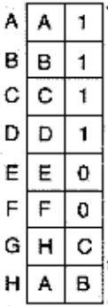
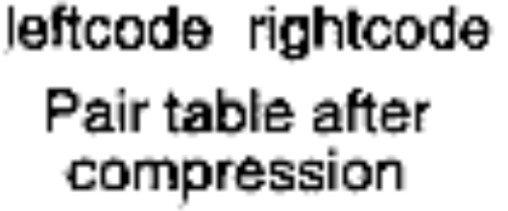
Compression – Algorithm (Example)
Available Character Set
Character Code
‘A’ 0
‘B’ 1
‘C’ 2
‘D’ 3
‘E’ 4
‘F’ 5
‘G’ 6
‘H’ 7
2. The pair table contains entries of those pairs of bytes that were replaced by single bytes within the buffer
|A|B|A|B|C|A|B|C|D| ➔ |H|H|C|H|C|D| ➔ |H|G|G|D|
Input string
Buffer contents after first pass
Buffer contents after second pass

Slide 5
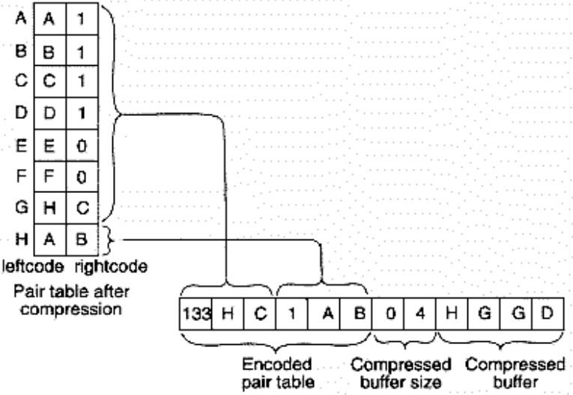
Compression – Algorithm (Example)
3. To compress the pair table, the algorithm steps through the table from the first entry thru its last entry, classifying each entry as representing a replaced pair or as not representing a replaced pair
Available Character Set
Character Code
‘A’ 0
‘B’ 1
‘C’ 2
‘D’ 3
‘E’ 4
‘F’ 5
‘G’ 6
‘H’ 7

Slide 6
Expansion
If a byte expands to a pair, and that pair contains one or more bytes in need of expansion, the algorithm will expand the newly created bytes before it reads any more from the input file

Slide 7
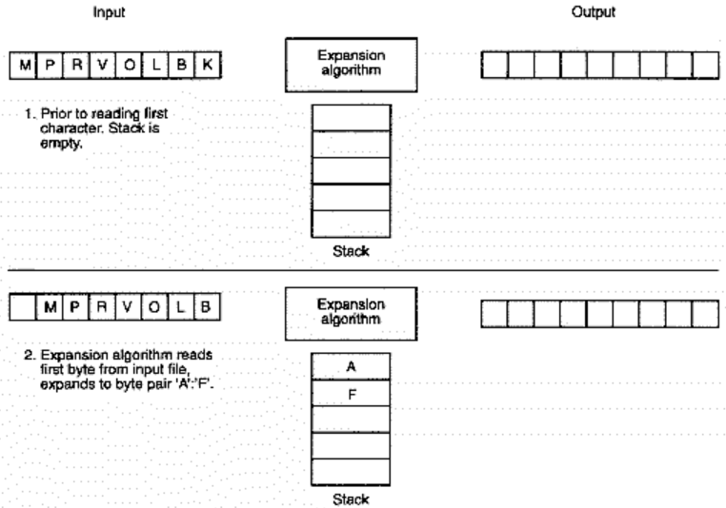
Expansion – Algorithm (Example)

Slide 8
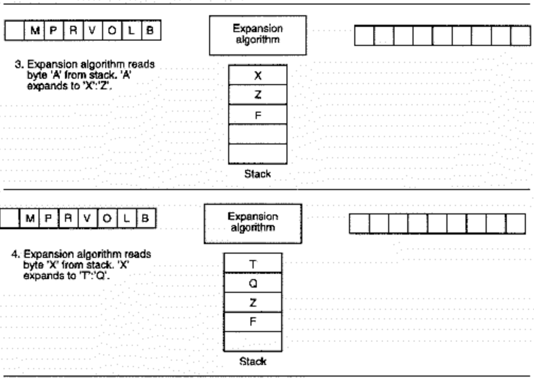
Expansion – Algorithm (Example)

Slide 9
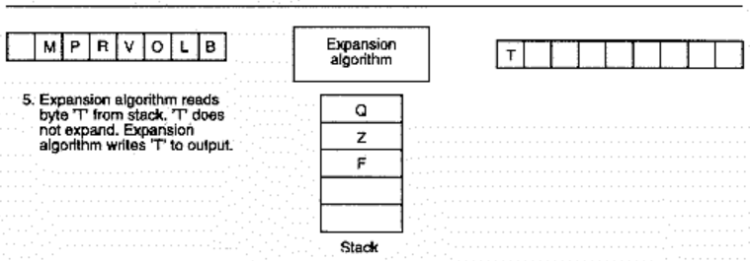
Expansion – Algorithm (Example)

Slide 10
Advantages of BPE
Compression never increases the data size (suitable for real-time applications);
If no compression can be performed, BPE passes the data through almost unchanged;
Better compression for BPE in some cases;
Both BPE's compression and expansion algorithms require little memory for data arrays, 5 to 30K for compression and only 550 bytes for expansion

Slide 11


Thank you for your attention
Article link
with C code

